Slide 1



Slide 2
Online Learning and Teaching
With a Visual Impairment
Deborah Armstrong And Mike Calvo

Slide 3

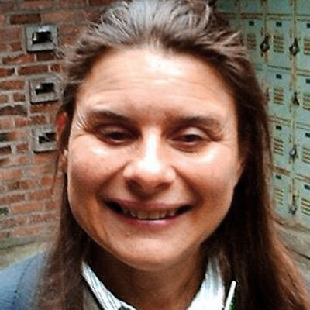
Mike Calvo
Pneuma Solutions
pneumasolutions.com
Deborah Armstrong
De Anza College
deanza.edu

Slide 4

The Five Ws
Who
When
Where
Why
What …
But HOW is the real meat!

Slide 5
WHO
K-12, college, university
State schools for the blind
For-profit (Southern New Hampshire University, University of Phoenix)
Corporate: employee onboarding, diversity, ethics, compliance: HIPA, FIRPA, etc.

Slide 6
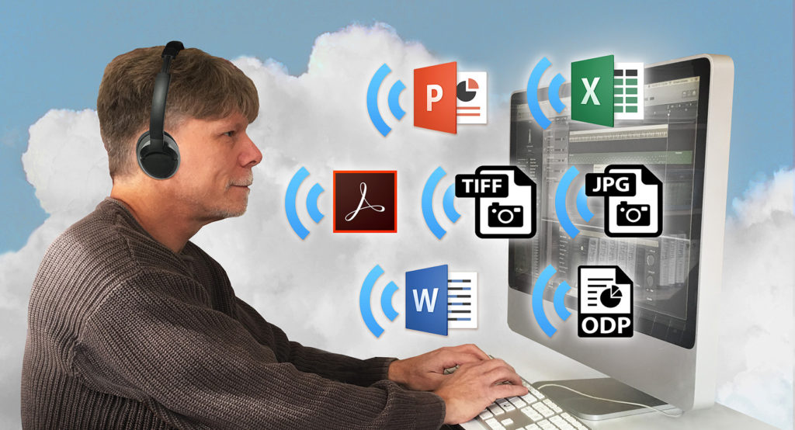
WHEN
Not in a physical place.
Synchronous vs.
Asynchronous

Slide 7
WHERE
Zoom/ WebX/Teams
Khan Academy
LinkedIn Learning (formerly Lynda)
Canvas/Moodle/Blackboard
SkillSoft
D2L
Sans Security
Hadley School
Coursera/EdX
Future Learn
Udacity/Udemy

Slide 8

WHY
Inexpensive
Convenient
Large groups
Flexible
Slower pace

Slide 9

WHAT
Self-paced vs. their pace
Computer vs. smart phone/tablet
Accessible study materials
Managing folders
Uploading, downloading
Demonstrating learning

Slide 10
ADVANTAGES FOR BVI LEARNERS
Repeat confusing concepts.
Showcase yourself minus prejudice.
Accessible exams and peer review.
Discussions.
Pausing to take notes.

Slide 11
DISADVANTAGES FOR BVI LEARNERS
No classroom comradery.
No immediate access to teacher.
Image-only handouts.
Inaccessible shared screens.

Slide 12
Remediation
What
How
Who

Slide 13
General Approach
Growth vs. fixed mindset.
Build a support system.
Think out of the box.
Work smarter not harder.
Practice with low-risk social media, Facebook, Meetup, Nextdoor.
Practice real-time note-taking with CNN or Fox.

Slide 14
LMS vs. Content
Uncovering what is accessible.
And what is not accessible.

Slide 15
LMS Platforms
Canvas
Blackboard
Desire To Learn BrightSpace
Pearson MyLab
Cengage Learning Lab
McGrawHill Connect and LearnSmart

Slide 16
Online Learning Components
Modules or pages
Discussion forums
Assignments
Quizzes/exams
Polls
Knowledge checks
Synchronous conferencing
Asynchronous chatting
Peer collaboration

Slide 17

The Pneuma Solution
Your teacher need not be the remediation expert.
All handled in the cloud.
Pneuma’s website can help you advocate: pneumasolutions.com

Slide 18
Is It Inaccessible?
Or Is It You?
Is it one piece or the whole thing?
Can other screen reader users work with it?
Does it save as text?

Slide 19
Learn to Use Your AT
JAWS training and webinars
https://www.freedomscientific.com/training/
NVDA training and support
https://www.afb.org/blindness-and-low-vision/using-technology/assistive-technology-videos/learn-nvda
or
https://www.nvaccess.org/product/basic-training-for-nvda-ebook/
Narrator has help too
https://support.microsoft.com/en-us/windows/complete-guide-to-narrator-e4397a0d-ef4f-b386-d8ae-c172f109bdb

Slide 20
Learn to Use Your AT
Mac support
http://www.applevis.com
or
https://support.apple.com/guide/voiceover/welcome/mac
or
https://www.apple.com/voiceover/info/guide/_1124.html#:~:text=sound%20effects%20descriptions%3A-,Open%20the%20VoiceOver%20Help%20menu%20by%20pressing%20VO%2DH.,description%2C%20press%20the%20Space%20bar
Tablets and Smartphones don’t always cut it

Slide 21
Are Parts Accessible?
E.G. Discussions and Exams, Yes.
Assignments and Videos, No.
Files Area, Yes.
Instructor lectures, Yes.
Zoom whiteboard, No.
Instructor pages, Yes.
Camera-phone photos of textbook pages, No.

Slide 22
Tips for Mastering Your AT
One keystroke a day.
Get training – plenty is free.
Use a rolodex or Notes app for logging useful hotkeys.
Practice, practice, practice!
Can you use a different browser?
Record step-by-step through encountered difficulties.

Slide 23
COPING On Your Own
Use JAWS OCR and touch cursor.
Don’t forget Windows magnifier or Mac Zoom.
Talk to your DSS, instructional designer, content creator.
Screenshare your issue with someone with knowledge.
Get good at surfing for answers.
Save PDF as text and email it to teacher.
Request slides before class.
Keep notes on access issues.

Slide 24
COPING With Others
Learning Ally College Success Program: https://collegesuccessbvi.org/
APH Career Connect: https://aphcareerconnect.org
ACB Community Calls: https://acblists.org/g/ACB-Community-Events
Blind Students Chapters and Affiliates
Lighthouse or commission for the blind
Senior center volunteer
Ham radio club
Internet mailing lists – sometimes called groups.
Aira, Be My Eyes

Slide 25
COPING Using Other Strategies
Reduce your class load with P.E.
Start a study group.
Use reciprocity as part of a team.
Physical anatomy and physiology 3-D models.
Alternate assignments.
Borrow library books on the topic.
Be a pest, email everyone, phone your support system.
Publicly shame big providers.
Insist on money back.

Slide 26
ADVOCACY
DSS
HR
Blindness organizations
Legal aid
Pneuma has correspondence you can modify
File a complaint

Slide 27
Free Training Resources
JAWS and Zoom-Text Training
http://www.freedomscientific.com/training
NVDA Training From AFB
https://www.afb.org/blindness-and-low-vision/using-technology/assistive-technology-videos/learn-nvda
Narrator User Guide
https://support.microsoft.com/en-us/windows/complete-guide-to-narrator-e4397a0d-ef4f-b386-d8ae-c172f109bdb1
Learning Mac VoiceOver
https://www.apple.com/voiceover/info/guide/_1124.html
https://www.perkinselearning.org/technology/getting-started/mac-voiceover
https://www.applevis.com/new-to-mac
Free online Training For Blind Students
https://catchthesewords.com/free-online-training-for-blind-students

Slide 28
Conclusion and Summary
Learning Platform vs. Content
Master your AT
Discover Pneuma Solutions
Many routes to achieve success

