Slide 1

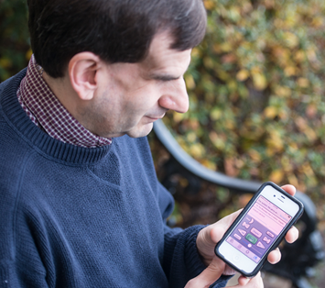
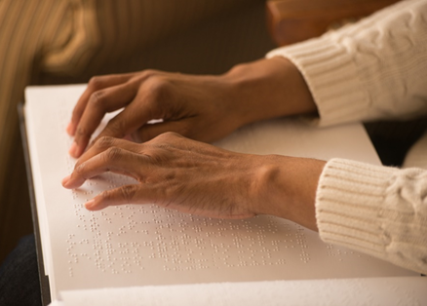
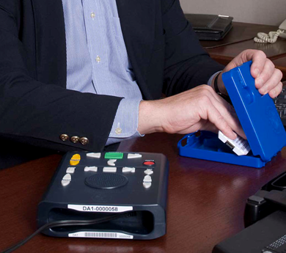
NLS Modernization Update
Jason Yasner, Deputy Director
NLS Patron & Network Engagement Update
Mark Santangelo, Chief, PNE
American Council of the Blind Convention
July 19, 2021

Slide 2
National Library Service for
the Blind and Print Disabled (NLS)
Vision Statement: That All May Read
Mission Statement: To provide books, magazines, musical scores, foreign language, locally produced materials and texts in braille and recorded formats to blind and print disabled individuals in the United States and U.S. citizens living abroad.
Modernization Objective: Over the next 5-7 years, NLS will double the number of blind and print disabled patrons it serves with digital audio and braille content delivered directly to patrons using various digital devices, including braille eReaders and smart devices.
American Council of the Blind Convention 2021

Slide 3
Modernization Initiatives
Consultant Analysis (Accenture and Deloitte)
Established Modernization Program Office
Hired Dedicated Program Manager
  Frederick Cooke
Market Research
Research and Development
Projects, Pilots, Field Tests, Focus Groups
Strategic and Directional Planning
American Council of the Blind Convention 2021

Slide 4
Modernization Program Office (MPO)
Mission: To implement the NLS Modernization Plan, Technology Roadmap, and develop Modernization project planning. Ensure higher levels of reliable service for NLS operations and patrons, as well as a continuously improved, managed, and operated NLS.
American Council of the Blind Convention 2021

Slide 5
Modernization Office
BARD and other IT Modernization
PICS Modernization
Next-Generation Playback Devices
Braille eReader Pilot
Marrakesh Treaty
Data Connectivity Provision
NLS Reorganization
NLS Relocation
American Council of the Blind Convention 2021

Slide 6
BARD and other IT Modernization
The current Braille and Audio Reading Download (BARD) System was originally design to be hosted on physical Library of Congress servers. This aging infrastructure is nearing its full capacity as BARD’s patron base has increased exponentially over the past few years. The increasing book search and download activity is also taking up a significant portion of LOC’s network bandwidth. The system must be migrated to the cloud and re-engineered to leverage modern cloud technologies, including AAA—a single sign-on application that will allow for patrons to access digital materials.
PICS Modernization
The purpose of the Production Inventory Control System (PICS) is to modernize NLS’s book production processes. The system is comprised of the following components: (1) BCS Client; (2) CDS Search; (3) ETL; (4) Signiant; (5) Label Composer; (6) MediaPulse (Workflow Engine); (7) Transfer Portal; (8) Solr; and (9) Validators.
American Council of the Blind Convention 2021

Slide 7
Next-Generation Playback Devices
NLS is investigating multiple avenues for a Next-Generation Playback Device to eventually replace the current Digital Talking Book Machine. These avenues include a Locked-down Smartphone, a Smart Speaker—both employing Voice User Interface capability—and a Stop-Gap Player aka DA-2. Current estimates show the DTBM inventory may be depleted in up to four years.
Braille eReader Pilot
The purpose of the Braille eReader pilot is to test the expansion of the NLS product offering to include a device that enables reading of electronic braille (a Braille eReader).
American Council of the Blind Convention 2021

Slide 8
Marrakesh Treaty
NLS has arguably the largest collection of braille and audio books eligible for exchange under the Marrakesh Treaty. NLS also serves a significant number of individuals in diaspora needing languages other than English for purposes of study, learning, and general reading. NLS and its network libraries therefore plan to participate fully in Marrakesh Treaty activities in order to advance access to published texts for NLS patrons and blind and print-disabled persons worldwide.
Data Connectivity Provision
In order to minimize the physical distribution of its materials and move toward an internet model with limited physical distribution, NLS undertook a project to assess the cost of providing mobile connectivity to patrons who would not otherwise be able to download or stream talking books and braille from NLS. Data transmission costs are expected to constitute a major component of future NLS expenditures, so careful modeling of these forecasted future costs is essential in forming estimates of future budget requirements.
American Council of the Blind Convention 2021

Slide 9
NLS Reorganization
NLS has implemented a reorganization of its organizational structure to more directly meet its mission, including a Congressional mandate to more precisely understand its patrons and to more efficiently process and deliver its products and services to its hundreds of thousands of dedicated patrons.
New Patron and Network Engagement Division was specifically designed to increase communication and collaboration with YOU, our patrons and stakeholders!
NLS Relocation
NLS has been seeking the relocation of its facility ideally to the 501 1st Street location to better serve its patrons in a more public capacity. The relocation for NLS has been studied and pursued for many years and based on the need to avoid another long-term lease as the current space (88K sf) is no longer a viable long-term solution.
American Council of the Blind Convention 2021

Slide 10
Next Steps
Monthly MPO Meetings
Annual Performance Goals Alignment
Modern Tools to Track Projects
NLS Collaboration Best Practices
Uniform Project Tracking Templates
Develop of Program, Project, and Product Management
Methodologies and Best Practices
American Council of the Blind Convention 2021

Slide 11
Patron and Network Engagement
Division
That All May Read
• Network Services • Music
• Patron Engagement • Reference
• BEP
Bureau of Engraving and Printing
American Council of the Blind Convention 2021
Notes:
Self-introduction; PNE introduction and description of Division.

Slide 12
Network Services
2020-2021 Network Library of the Year
Iowa Library for the Blind and Print Disabled
Virginia Beach: Bayside and Special Services Library
Duplication on Demand
Circulation modernization to improve access for patrons
Network Communications
Creating conversation to better understand the needs of the network and our patrons
American Council of the Blind Convention 2021

Slide 13

Music
• NLS 90th Year Celebration
Jazz pianist, Matthew Whitaker
• 24,000 Titles of Braille Music
Over 2,800 audio books on music appreciation & instruction
• Music Blog
Professionally trained musicians
Music Section nlsm@loc.gov, 1-800-424-8567
American Council of the Blind Convention 2021

Slide 14
Patron Engagement
Connecting with our Patrons
New Section Head position
Education & Training Specialist
Consumer Relations Officer
Assistive Technology Specialist
American Council of the Blind Convention 2021

Slide 15
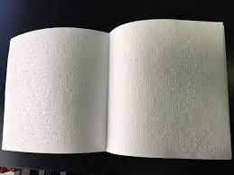
Reference
NLS Information Center
Publications
Statistics
Reference Email: nlsref@loc.gov, 202-707-9275
American Council of the Blind Convention 2021

Slide 16
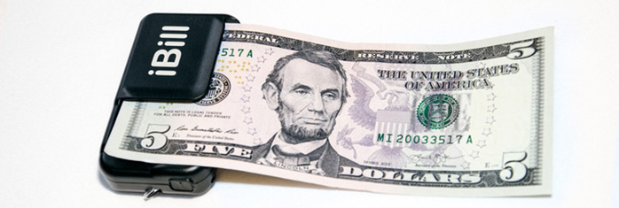
BEP
Bureau of Engraving and Printing
US Currency Reader Distribution Project
Seven Year Partnership Between BEP and NLS
American Council of the Blind Convention 2021

Slide 17
202-707-2255
Questions?
Jason Yasner
Deputy Director
202-707-2255 jyas@loc.gov
Mark Santangelo
Chief of Patron and Network Engagement Division
202-707-0441 msantangelo@loc.gov
American Council of the Blind Convention 2021

