Slide 1
Everything Old Is New Again!
Welcome to the New APH ConnectCenter
American Council of the Blind - ACB
July 21, 2021
Notes:
OLAYA

Slide 2
APH ConnectCenter Mission
Our Mission
The APH ConnectCenter offers curated information and resources to assist children, parents, adults, job seekers who are blind or visually impaired, and their associated professionals, leading to greater independence and success in their lives.
Notes:
OLAYA – Lets look at what we’re talking about: Class of 2020 Video – Forge Your Own Path: https://youtu.be/sNzajIX0tZ4

Slide 3
The APH ConnectCenter Is …
Websites
Resources
Webinars
People
Notes:
OLAYA

Slide 4
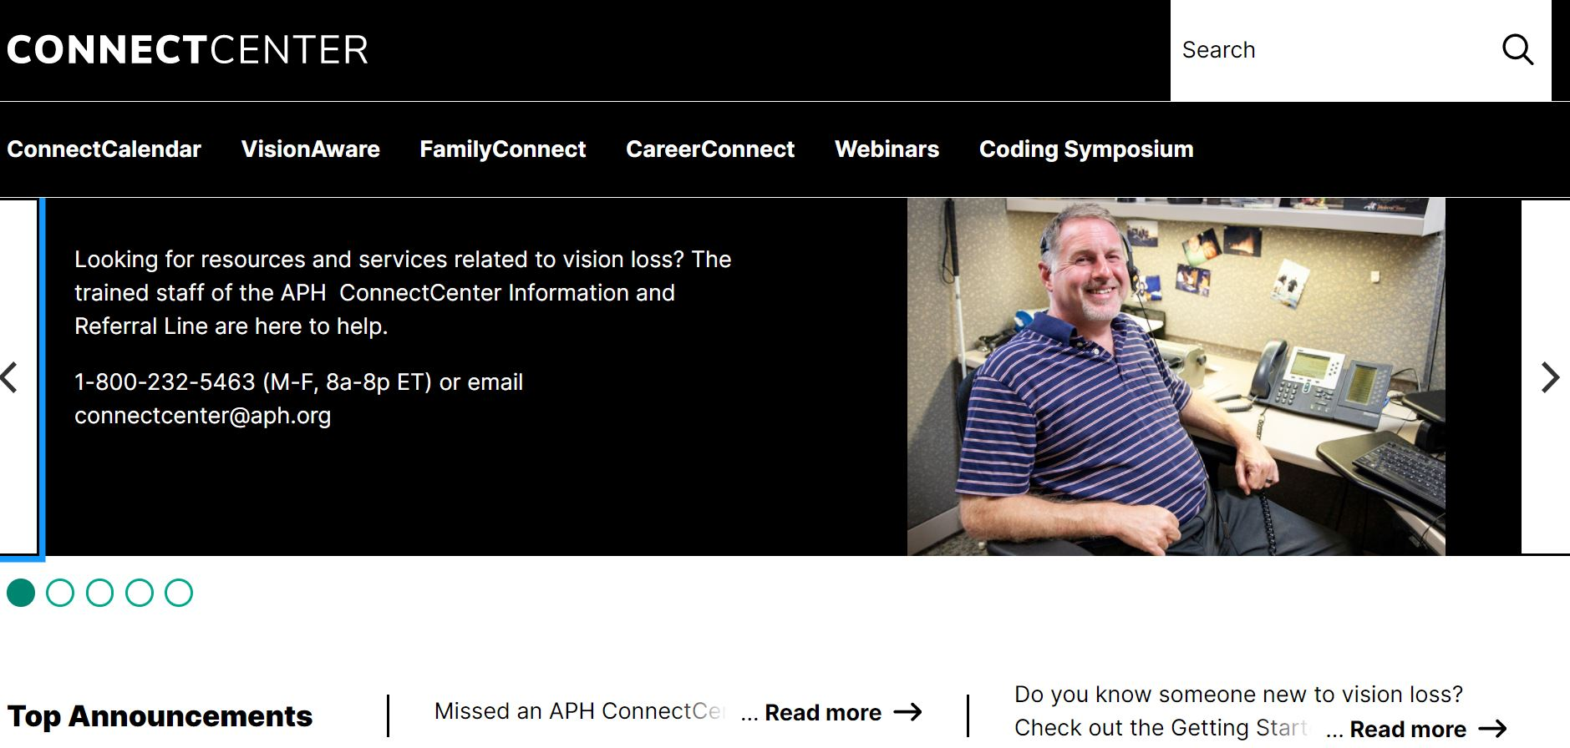
APH ConnectCenter
Notes:
KATHRYN

Slide 5
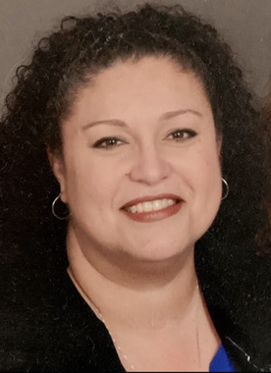
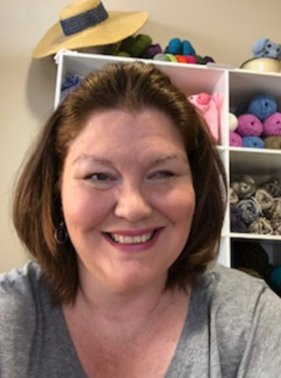
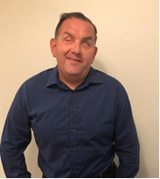
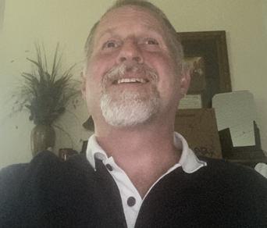
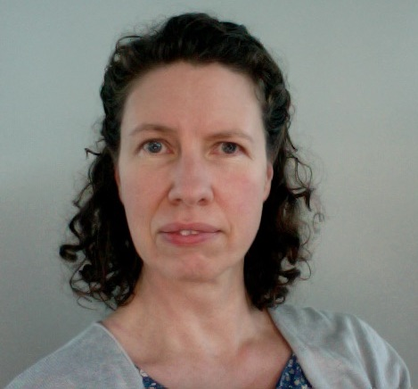
Our Team
Richard Rueda
Kathryn D Botsford
Alan Lovell
Dr. Olaya
Landa-Vialard
Melanie Peskoe
Pris Rogers
Notes:
OLAYA

Slide 6
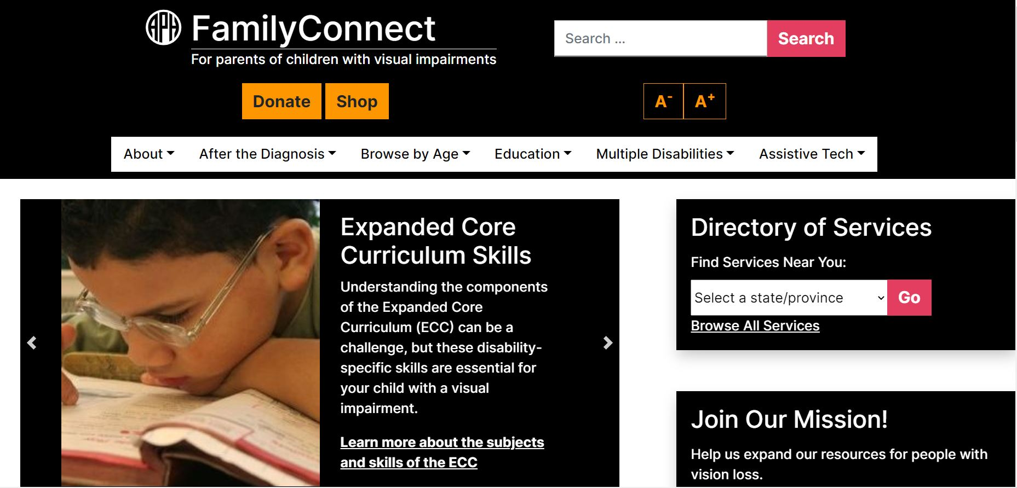
FamilyConnect
Notes:
KATHRYN

Slide 7
FamilyConnect Resources
Parent Advisory Program
Webinars:
  ParentConnect – Parent Support Group (1st Wednesday of each month 7pm Eastern/4pm Pacific)
  The Homework Hotline
Blogs & Articles:
  Transition: Preparing Your Student for Success in the Computer Coding Field
  Camping With Your Child Who is Blind or Visually Impaired
  Help! What Can I Do With Ample Summer Free Time for My Child Who is Blind or Visually Impaired
Videos and Personal Stories from Families
Notes:
KATHRYN – Visual Drive by aphconnectcenter.org

Slide 8
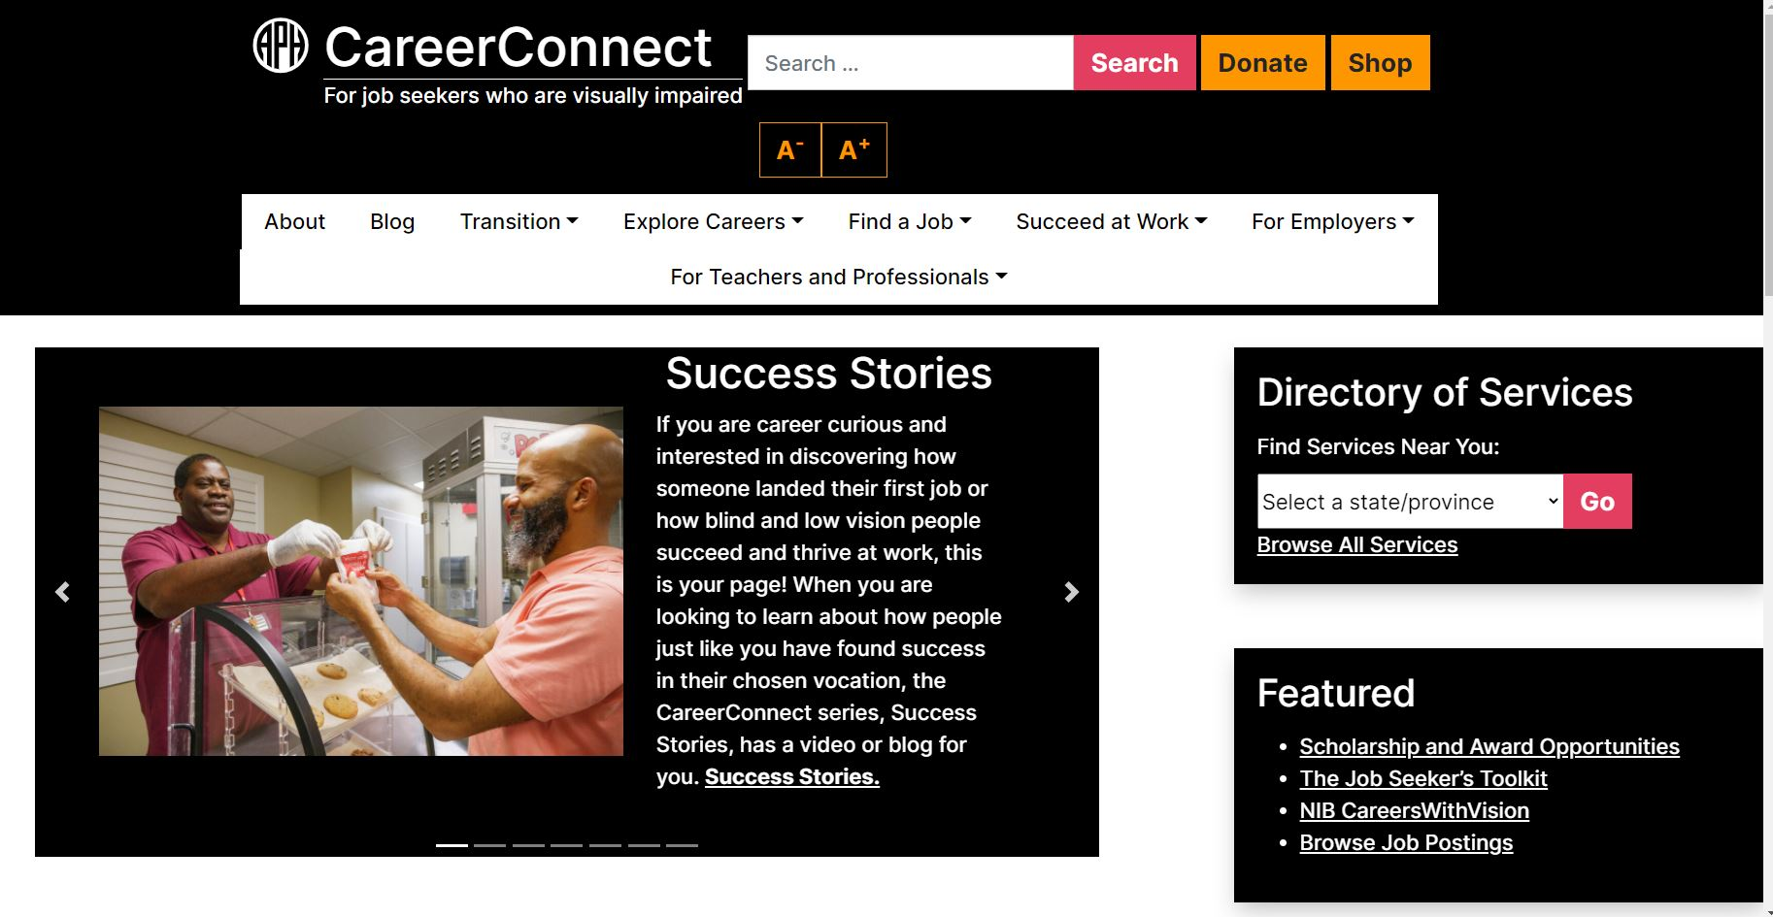
APH CareerConnect
Notes:
KATHRYN – General over of connect center

Slide 9
CareerConnect Resources
The Job Seekers Toolkit & Maintaining Employment Guide (being updated)
National Coding Symposium Co-Sponsored with California School for the Blind
Blogs and Articles:
  Juggling the College Experience: It’s About Time
  Bread, Rice, or Tostada – Cultural Inclusion at The Transition Table
  Gearing Up for Success: Exploring Career Possibilities with Vocational Rehabilitation Services!
Video Success Stories: Joe Hodge – APH & Russell Shaffer – Walmart
Notes:
KATHRYN – Visual Drive by aphconnectcenter.org
JobSeeker’s Toolkit and Maintaining Employment Guide ported to a learning management system to make it interactive with modules and quizzes

Slide 10

APH ConnectCenter Transition Hub
Made possible through generous funding from:
Launching Summer 2021
Perkins Compass
Vision Serve Alliance
AERBVI
35 Transition Agencies Nationwide
Follow us on social media for updates
CareerConnect Twitter and YouTube
Notes:
KATHRYN
https://www.facebook.com/ccforjobseekers
http://www.twitter.com/aphconnect
https://www.youtube.com/playlist?list=PLUj6DcM1nN3HCfWxJIMLPeD8roKZt8xyu

Slide 11
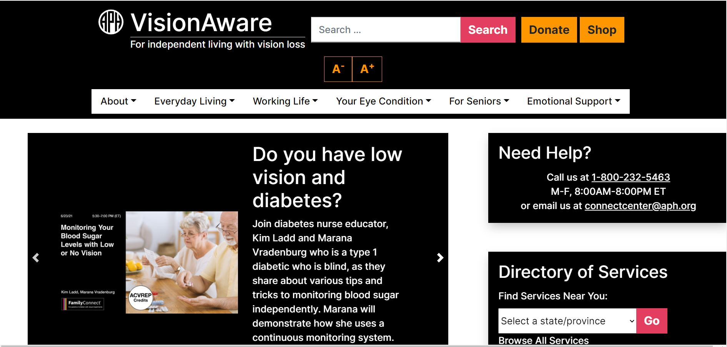
VisionAware
Notes:
OLAYA – general overview

Slide 12
VisionAware Resources
The Getting Started 2020: A Guide for People New to Vision Loss
A Guide to Vision Loss for Family and Friends
Diabetes Education Program
Blogs:
  How Can You Monitor Your Sugar Levels With Low or No Vision
  The Benefits of Working: SSI / SSDI
  Review of Online Guide: “Smartphone Apps and Resources for People with Vision Loss or Impairment”
Videos and Personal Stories About Living with Vision Loss
Notes:
OLAYA – Resources
KATHRYN – Visual Drive by aphconnectcenter.org

Slide 13
Additional ConnectCenter Resources
We're more than the websites
Notes:
OLAYA

Slide 14
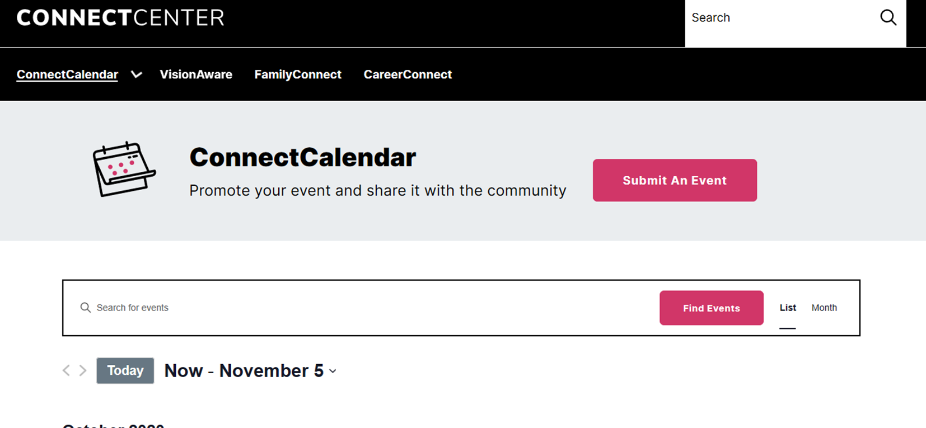
ConnectCalendar
Notes:
OLAYA
KATHRYN – Visual Drive by aphconnectcenter.org
Direct to find an event
https://aphconnectcenter.org/events/

Slide 15
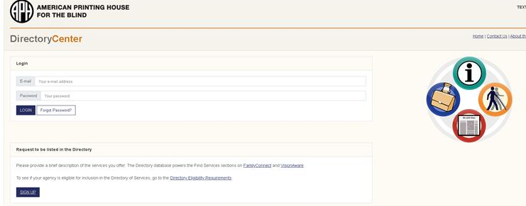
Directory of Services - Registration page
Notes:
OLAYA
KATHRYN – Visual Drive by aphconnectcenter.org
Search directory - https://aphcareerconnect.org/directory/
sign up - https://aphdirectory.org/signup

Slide 16
APH ConnectCenter Contacts
The APH Information & Referral Hotline
1-800-232-5463 (U.S. and Canada)
staffed M-F 8:00AM-8:00PM EST
Email: connectcenter@aph.org
Directory of Services with over 2,000 profiles of agencies serving people who are blind or visually impaired.
Notes:
OLAYA

Slide 17
APH ConnectCenter Funders
Funding Sources
The Gibney Family Foundation
Delta Gamma Foundation Service for Sight Program
Lavelle Fund for the Blind, Inc.
LG&E Community Grants
HumanWare
Reader’s Digest Partners for Sight Foundation
Notes:
OLAYA

Slide 18





APH ConnectCenter Partners
Our Partners
Notes:
OLAYA

Slide 19
Partner Programs
Chicago Lighthouse for the Blind
College Success at Perkins: Compass Program
Vistas Education Partners: Homework Hotline Series
Vision Serve Alliance
Be My Eyes “Special Help” Community Partnership
OIB-TAC Public Service Announcement
Helen Keller National Center
AER Chapters – Webinar Content
Illinois School for the Visually Impaired Early-Intervention
Lovett Productions
Notes:
OLAYA

Slide 20


CareerConnect: Class of 2020
Notes:
OLAYA -
The Greatness Inside of You: https://youtu.be/GZcD8ExfY9A?list=PLUj6DcM1nN3HCfWxJIMLPeD8roKZt8xyu
All Videos available on the APH ConnectCenter YouTube Channel but easier to find on the CareerConnect Websiite at: https://aphcareerconnect.org/succeed-at-work/our-stories/ Look under Success Stories
Get Out Tthere and Get After It: https://youtu.be/-mYTjOzYcMY

Slide 21
APH ConnectCenter Webinars
aphconnectcenter.org (click on the webinars tab)
3/18/21 Getting to Know the National Homework Hotline for B/VI Students (NHH-BVI) 03/29/2021 Thriving Blind with Kristin Smedley
04/05/2021 Teen Tech Talk With Michael and Mitch Smedley
04/12/2021 EI/VI Braille 101
06/14/2021 E/VI Roundtable: Conversations With Parents
8/4/2021 ParentConnect – Chicago Lighthouse and Family Connect Parent Group (1st Wednesday of each month)
Notes:
KATHRYN

Slide 22
THANK YOU!
ConnectCenter Team
APH ConnectCenter at
https://aphconnectcenter.org
Email us at: connectcenter@aph.org
Follow us on Facebook
@FamilyConnect @CCForJobSeekers
@VisionAware
Twitter @APHConnectCenter and YouTube
Notes:
OLAYA

